Slide 1
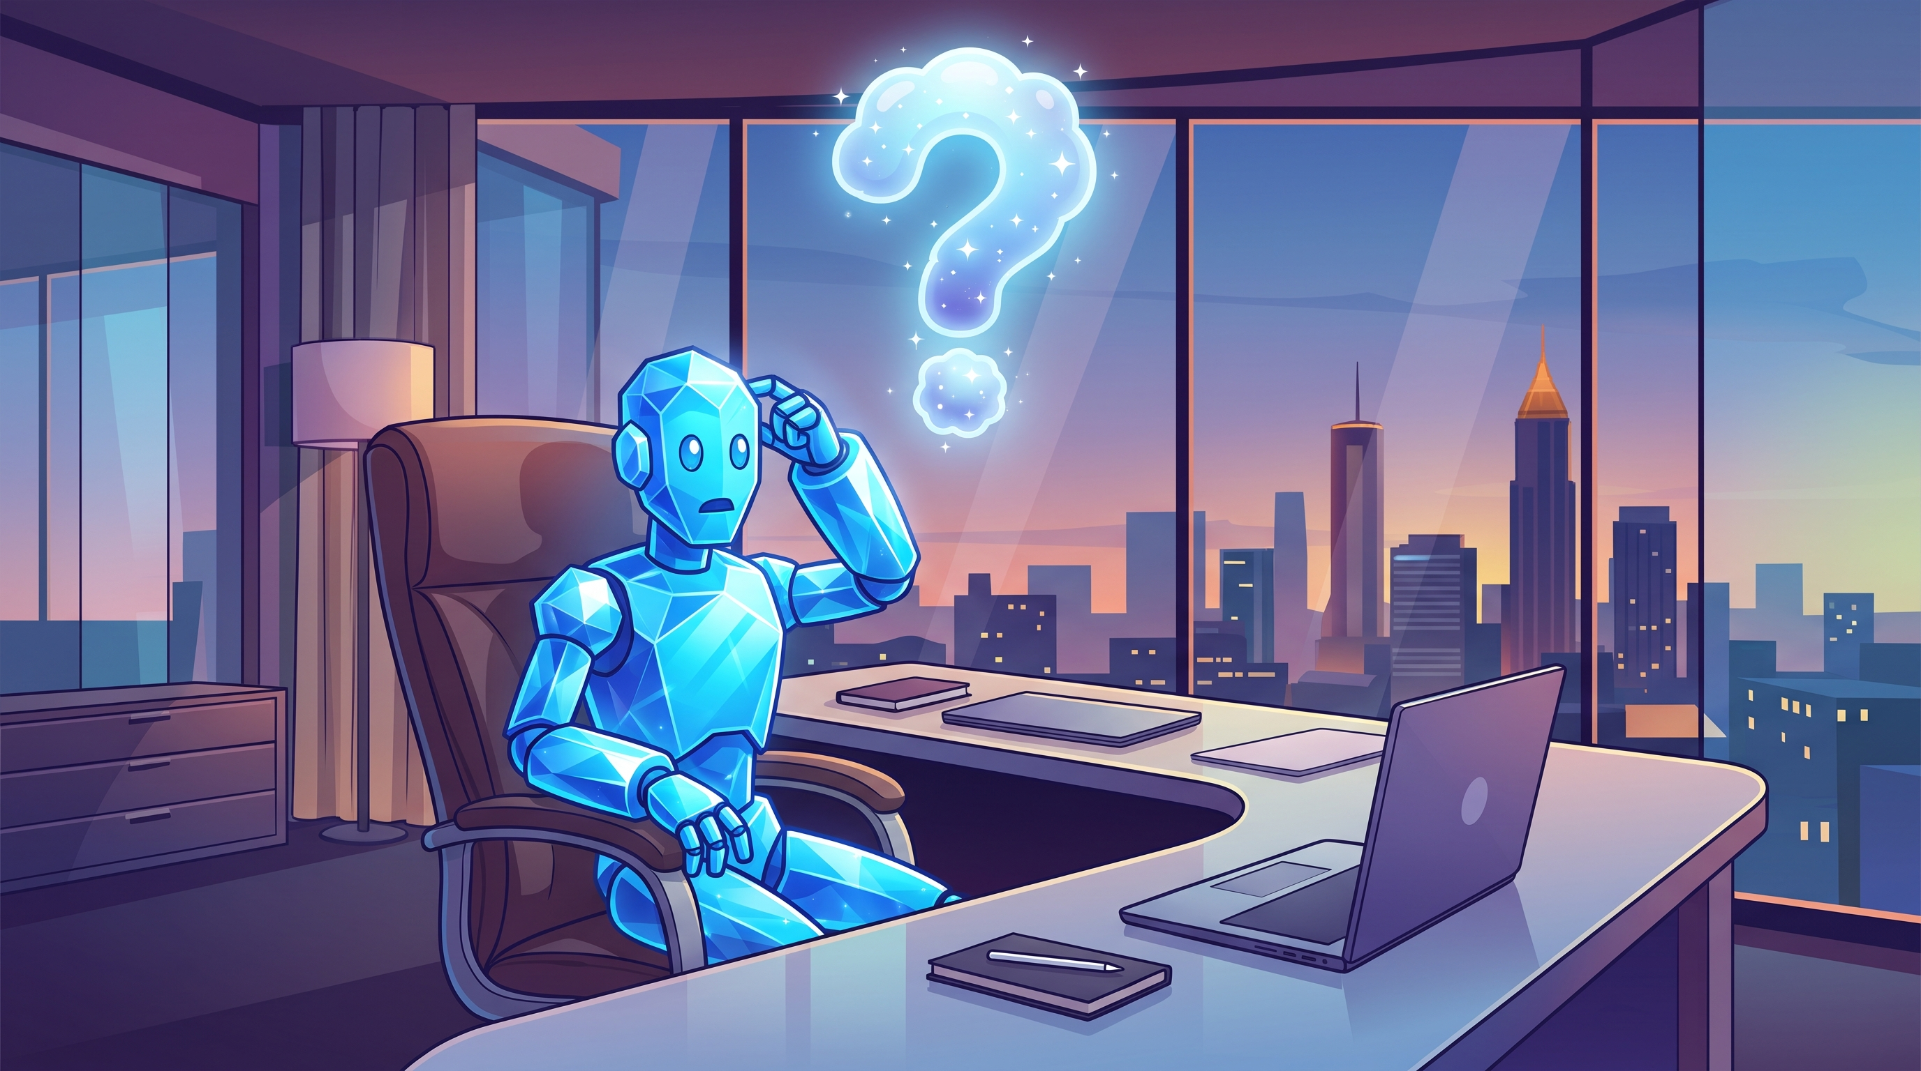
AI Helped Devs, Now It Needs to Help QA
An optimistic Presentation about Agentic Engineering
With your host, the lovely and talented
Chris Perrin
[ KCDC · Kansas City, Missouri · September 11, 2026 ]

Slide 2

Agenda
Who is this guy?
AI has changed software development *gasp!*
How we got here - What that has meant for the last “era”
Where we can go soonest - What helping QA means for now
The future - What it should mean very shortly
I don’t believe in presentations. I believe in conversations.
If you have questions, don’t wait until the end.
3

Slide 3
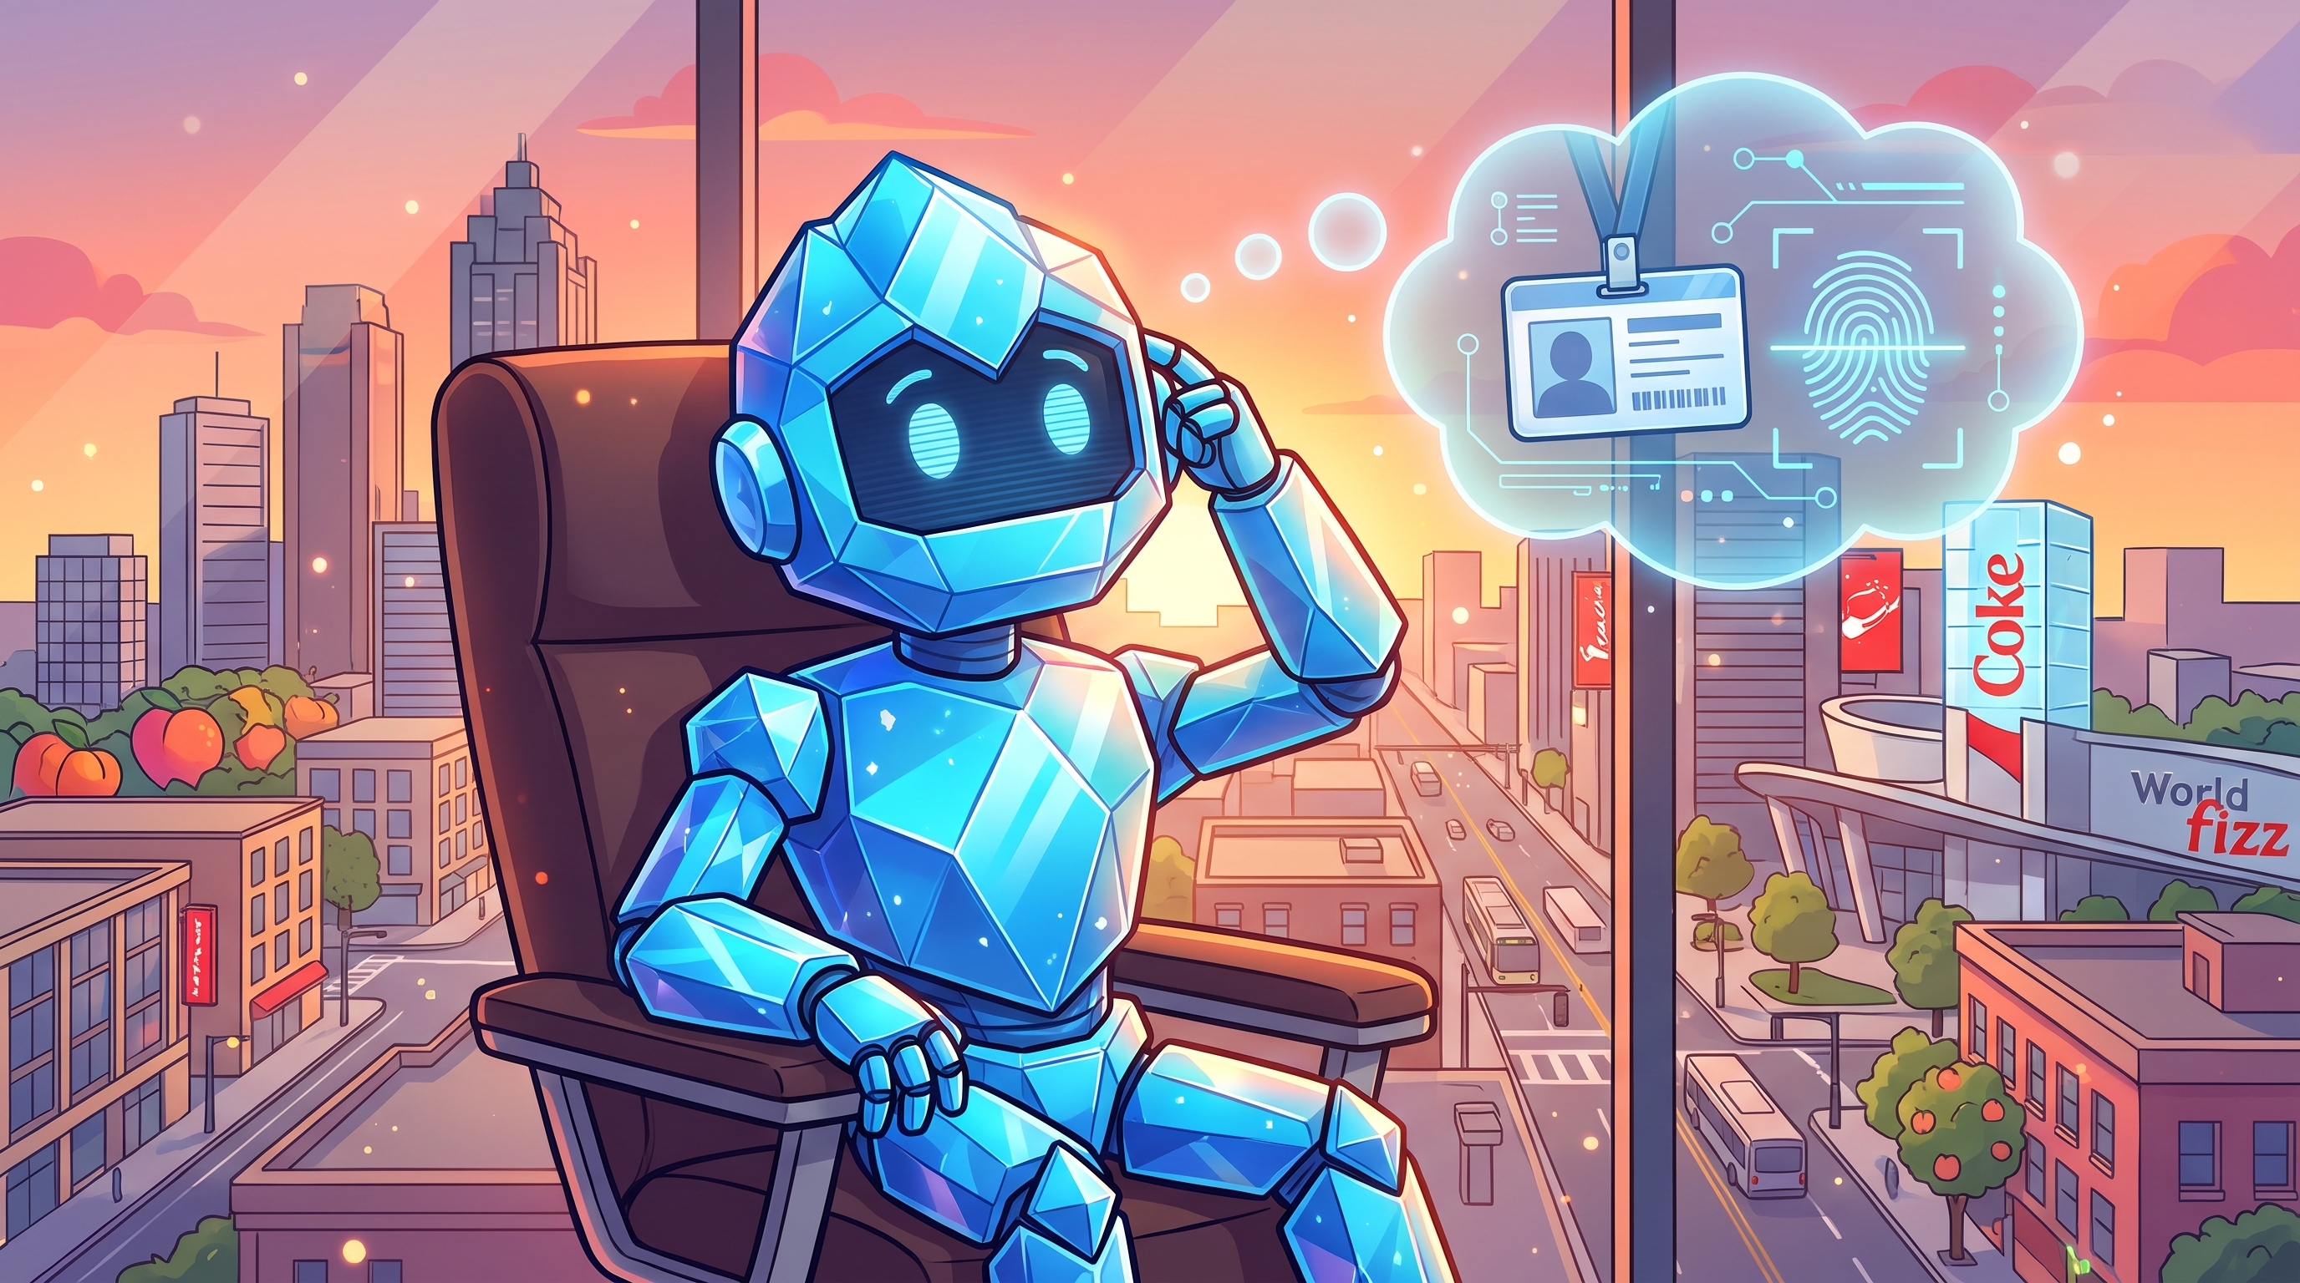
Who am I?
A man once called right by ChatGPT
Long time engineering leader. I have been leading longer than some of my team have been alive.
We have 3x’d our devs. 4x’d our product team. QA went gray.
Came up through dev, have had QA report to me
As a dev, I never once told my QA manager he was a crab person
I believe in “dynamic tension” between QA and dev
As the Taylor Swift of AI conferences (don’t believe me?
Ask Travis @killatrav), my Speed Era is over.
I’m into my Quality Era.
3

Slide 4
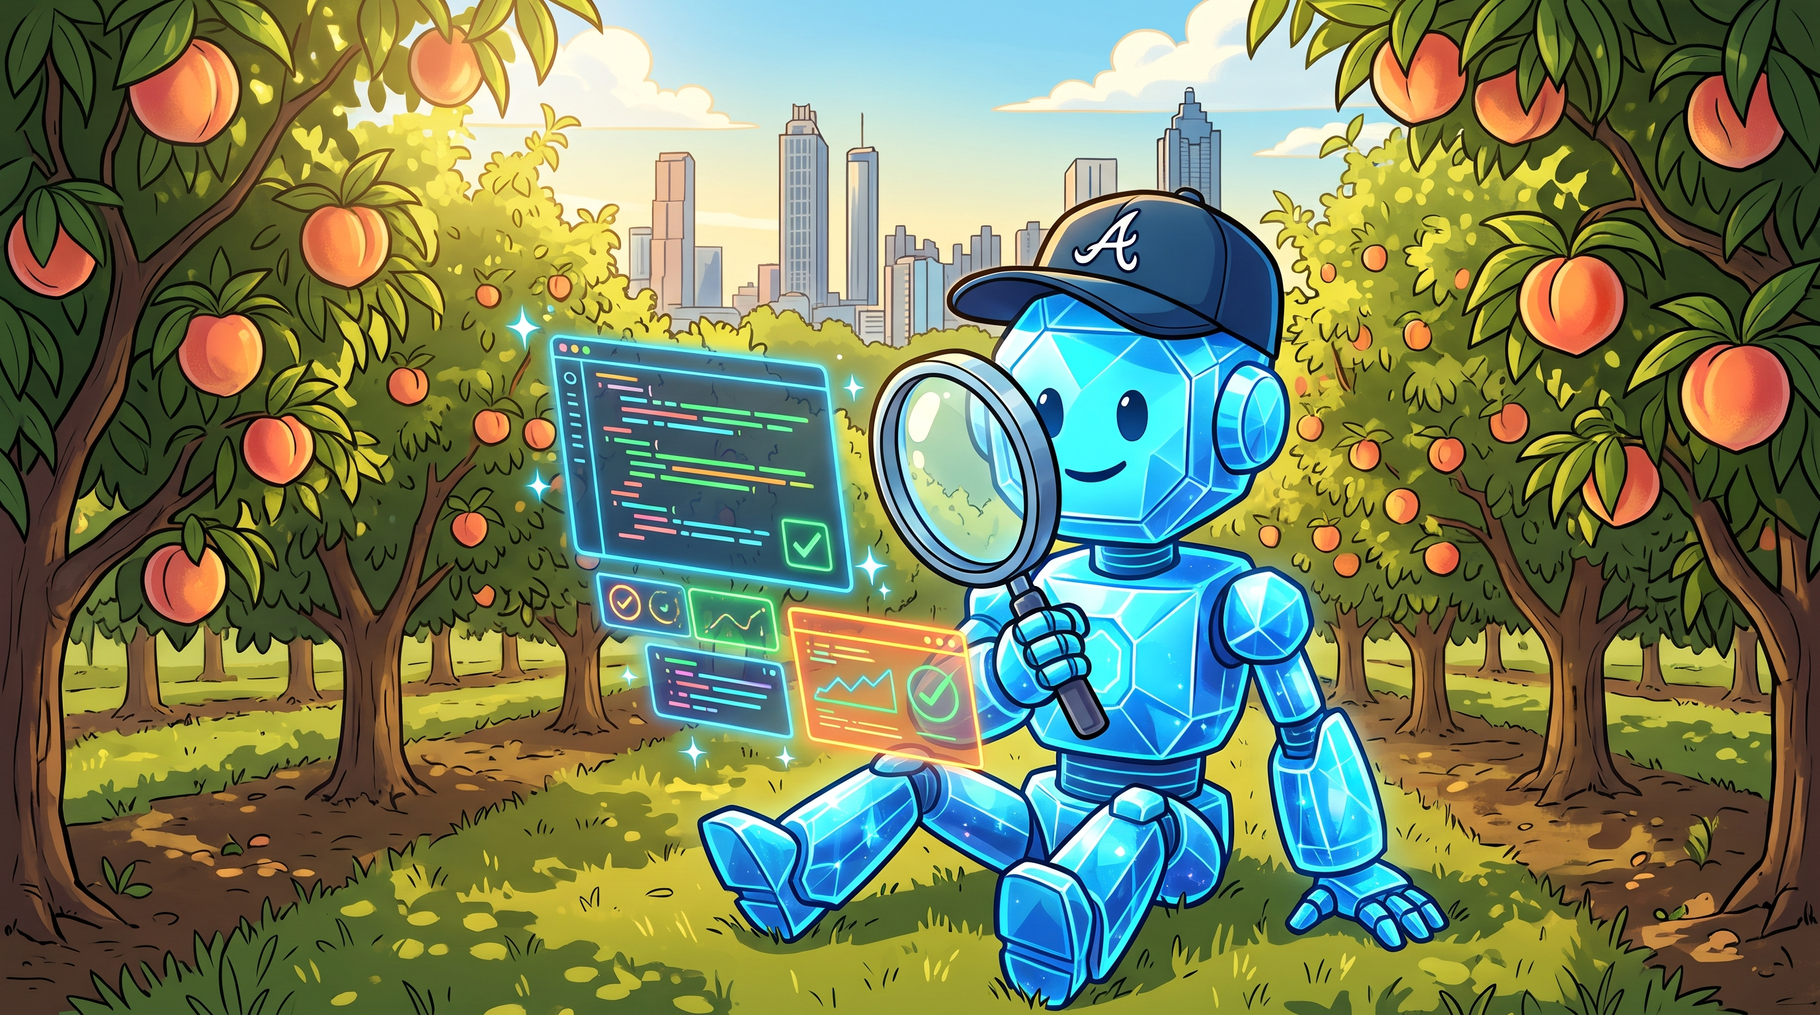
01
How we agentically got to this point
In quality

Slide 5
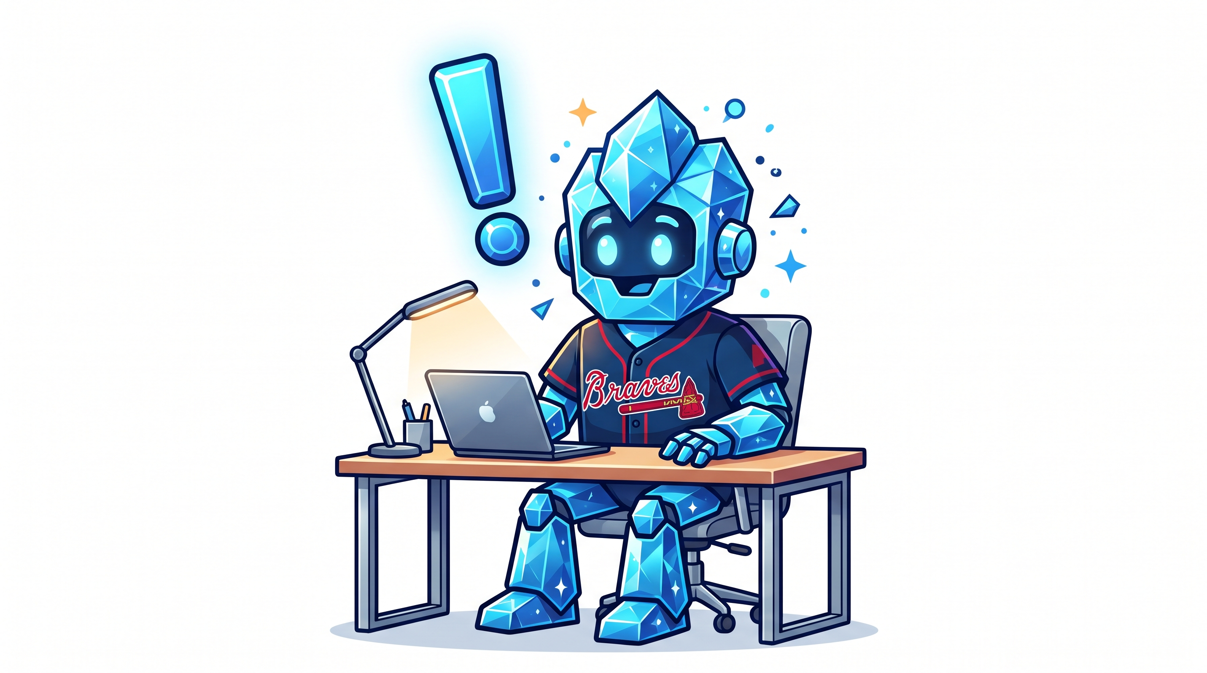
AI appears to have affected software development
Shocking, I realize!
A long time ago (2024), AI was dev-focused
In early 2025, I asked my QA manager if he wanted to go to a conference and he couldn’t find one with a QA track
This is no longer the case (I mean, you’re here, right?)
Industry today is still speed, speed, speed.
The assumption is that our devs have more time.
Also, the there’s more that needs to be tested
and more bugs.
3

Slide 6
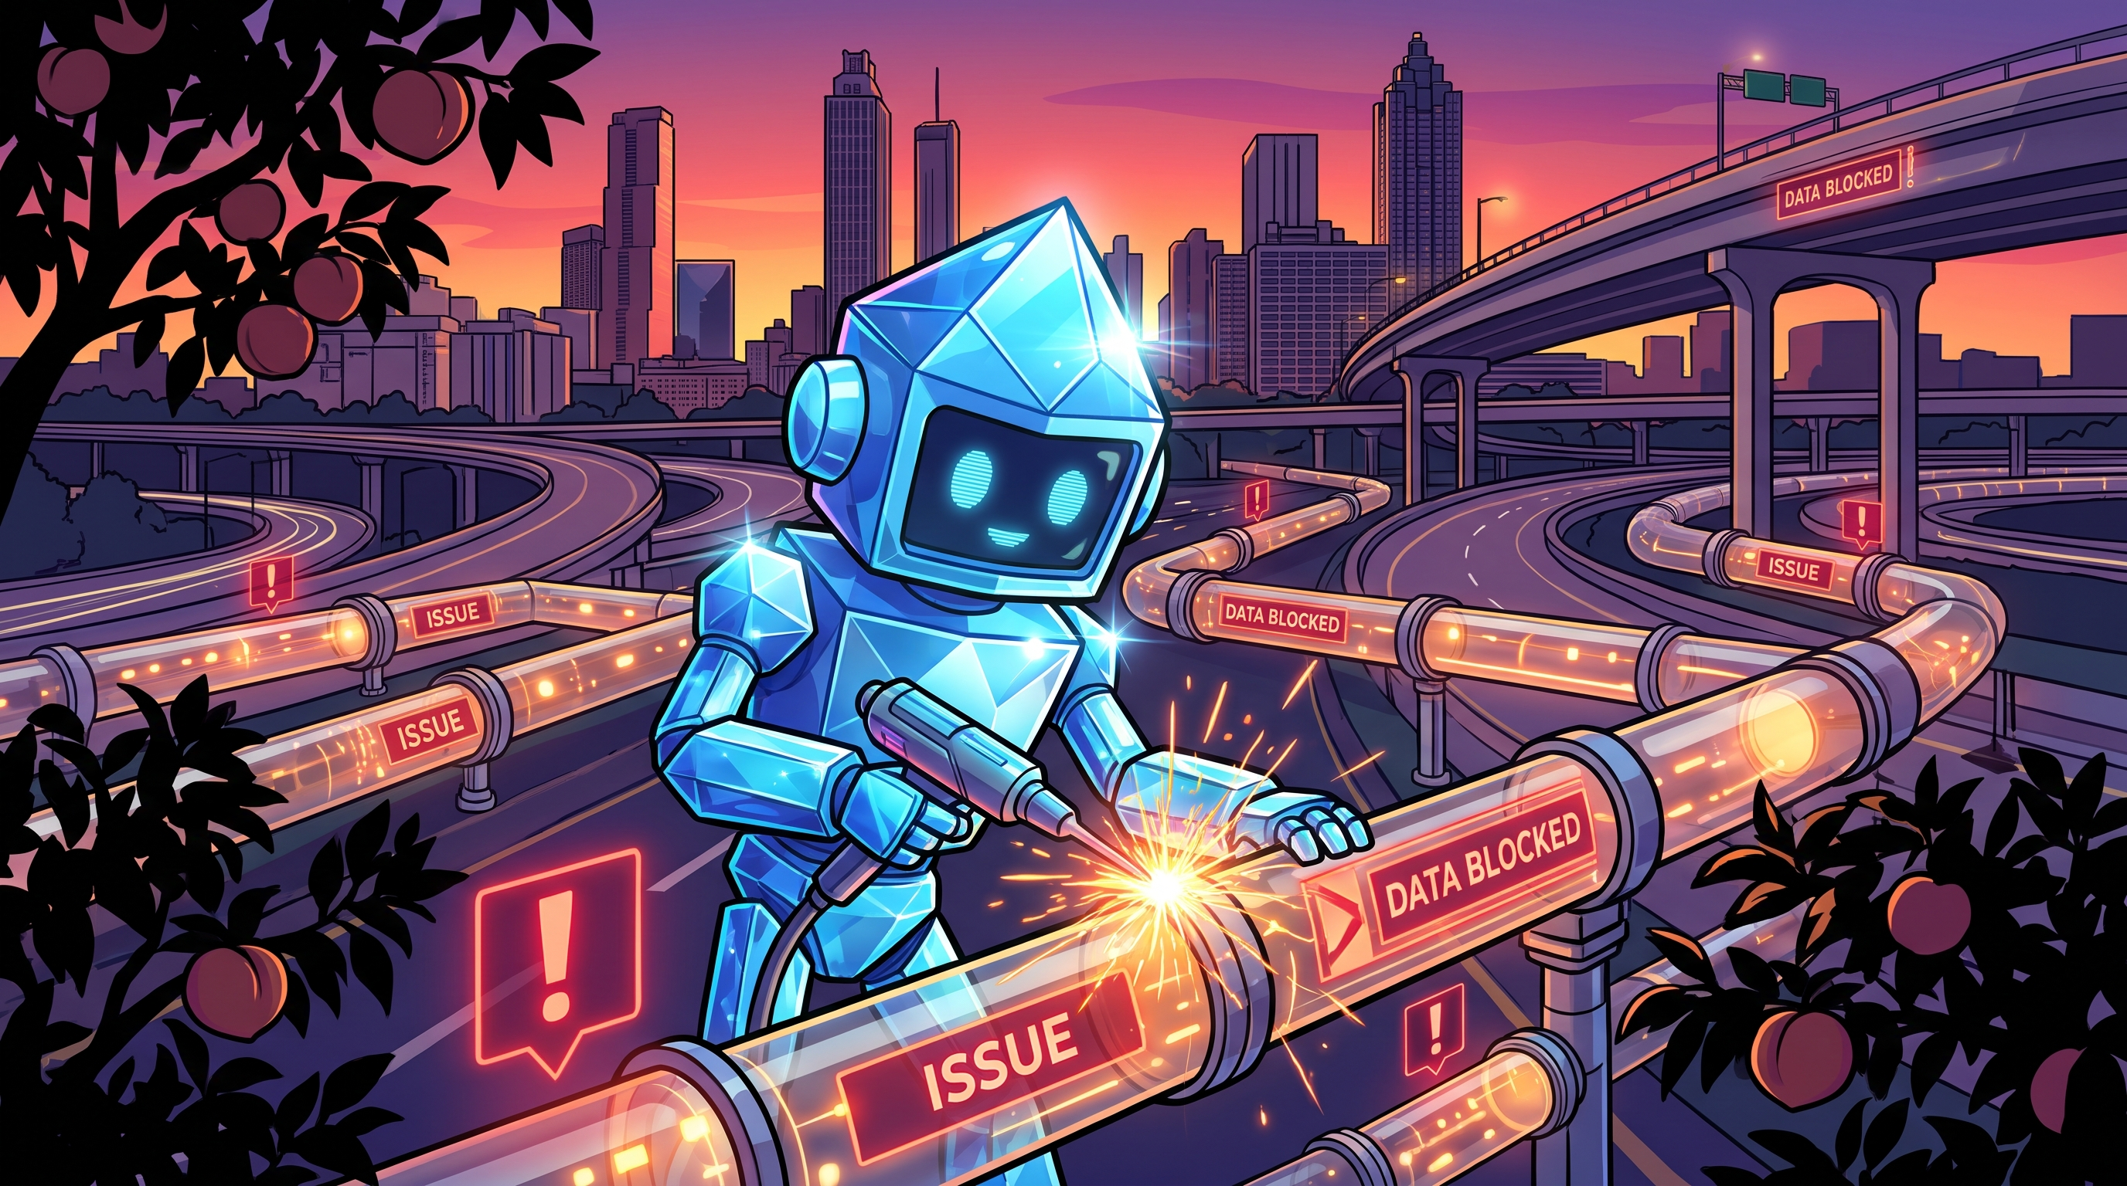
AI has meant one thing: speed, speed, speed
3

Slide 7
The scary numbers slide
55% increase in errors and 1.3-1.7x increase in critical bugs
81% of engineering leaders report
AI-related production issues
43% of AI-generated code needs manual debugging in prod
3

Slide 8
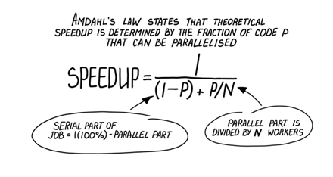
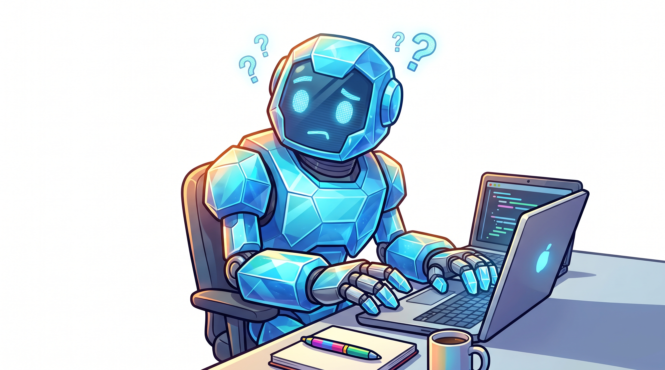
Amdahl’s Law
Courtesy of Grokking Concurrency
3

Slide 9
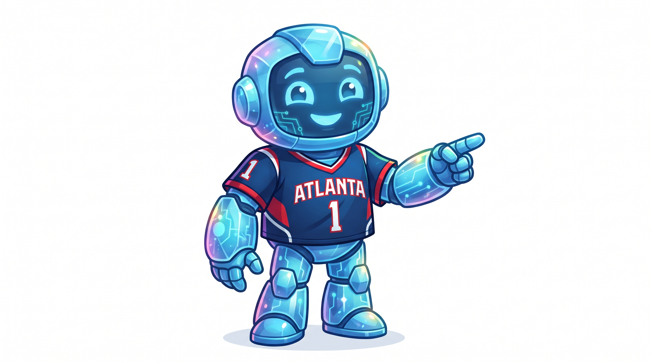
Perrin’s Law
In technology, first we make it fast. Then we make it good.
-- Chris Perrin @helpfulaiguy
3

Slide 10
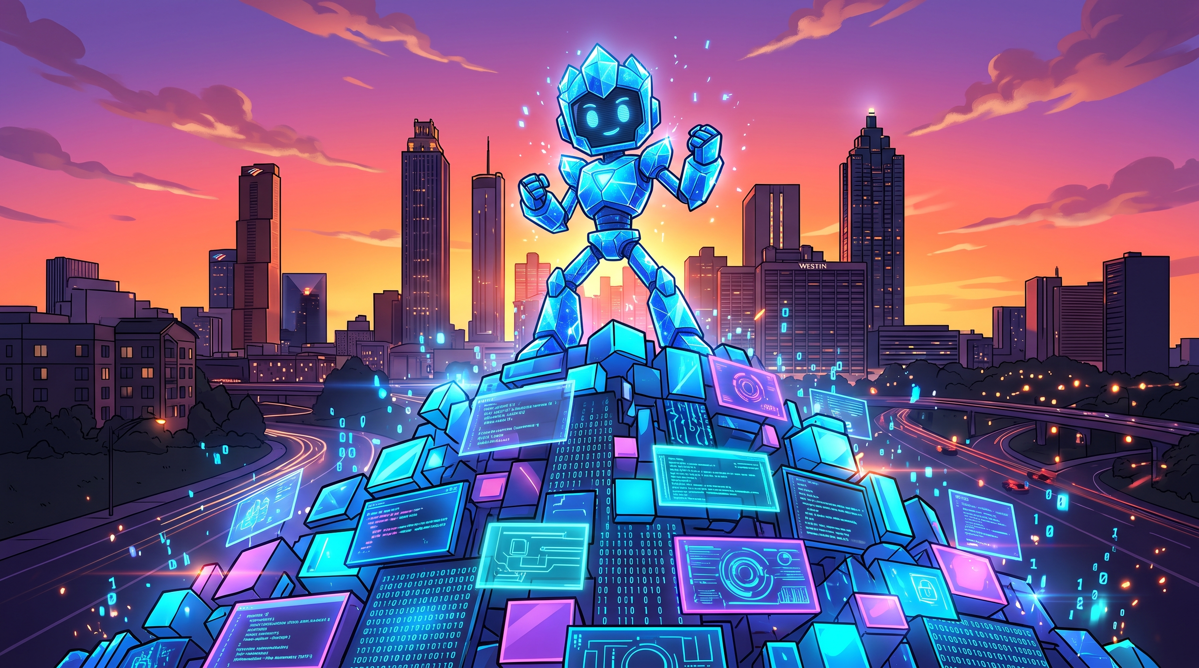
I can build a mountain of code
If I can do it, so can you.
So can my team.
We don’t have a lot of control over how the code is built.
The code is pretty good and it makes a lot of metrics light up GREEN.
But is that the right metric?
Does it take quality into account
Speed is not a bad metric, but it’s not a pipeline and
written code is not deployed code
Does your environment let you deploy at agent speed?
The industry continues to optimize for speed
3

Slide 11
What does quality look like in the age of AI?
It’s the right question. Especially if you’re on X and you like argue.
I’ve never seen so many developers care about code quality before
If you believe AI should do the code and the quality, you’re right, but…
  Sssshhhh! I’m a lot closer to that than I appear
  I have a day job that “kindly” said no
  Humans do have a place in the loop
Developers have no excuse not to do what we always
should have been doing
Speeding Up Agentic QA · Kansas City, MO
3

Slide 12

Every agentic journey is different
By now, if AI is incorporated into your SDLC, then I expect at least some of these to be true
You, too, are writing a mountain of code
AI is writing some or all of your unit tests
AI is writing some or all of your E2E tests
AI is writing some or all of your documentation (docu-what?)
AI is starting to build its own context
Your sprint/kanban flows are roughly the same and user stories
are roughly the same
And if not, that’s fine, too
Speeding Up Agentic QA · Kansas City, MO
3

Slide 13
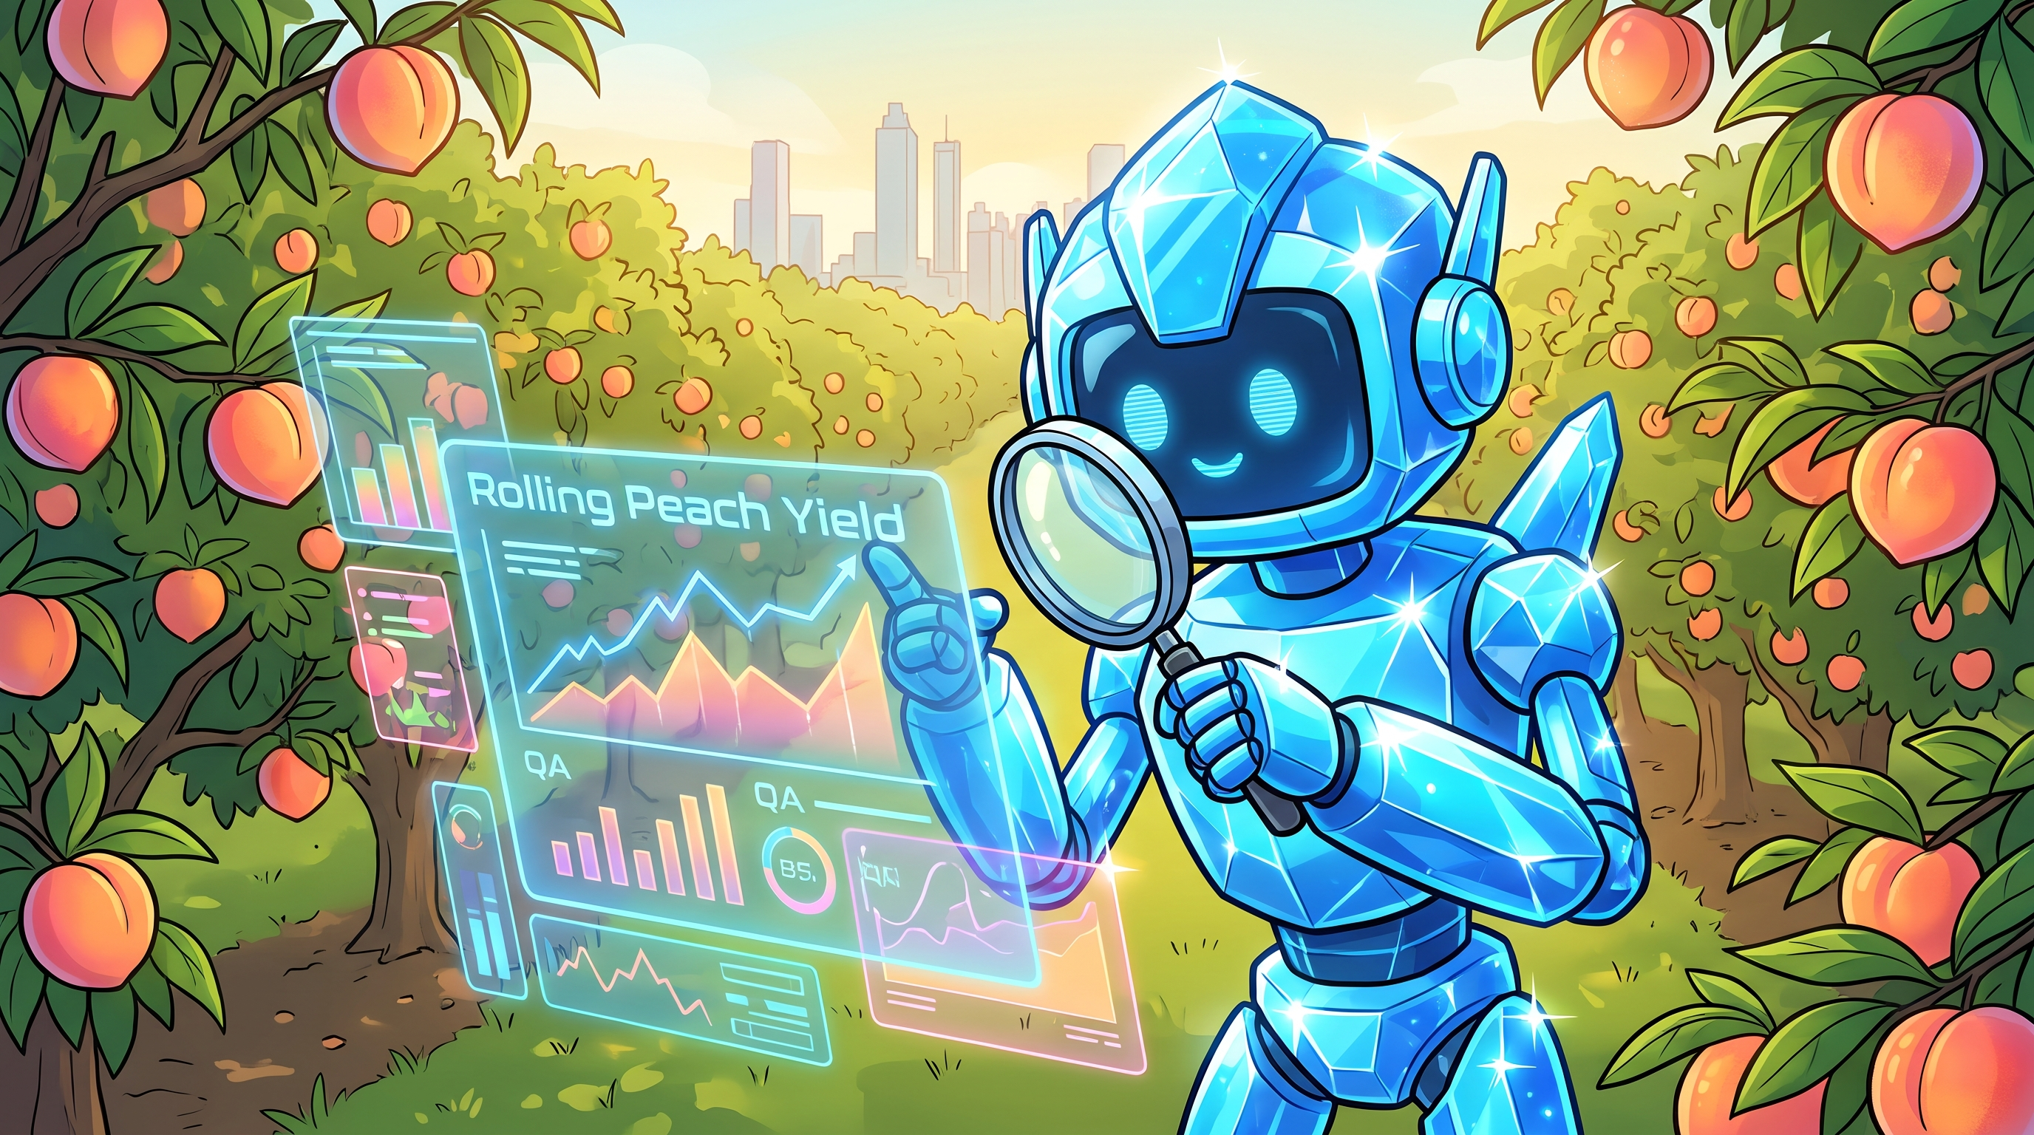
02
Optimizing for QA Now

Slide 14
What is your SDLC? How many pieces are ready for AI?
Infrastructure
Product Management
Product Ownership
Dev
QA
DevOps
SREs
Deployment
Speeding Up Agentic QA · Lincoln, Nebraska
3

Slide 15
Dev – A New Mindset
What do we do with our time?
Developers need to adopt a QA mindset
Developers need to be reviewing while AI is churning
Developers need to expand reviews beyond just what changed
This is a skill that devs* needs to grow
This can no longer be part of the ritual, it needs to be gate
Running the code still has to happen
Pay careful attention to how AI is used
But we know we’re faster
*Hi, it’s me. I’m devs.
Speeding Up Agentic QA · Lincoln, Nebraska
3

Slide 16
Dev – What we do with that time: “All Time AI 0-10”
Store decision context in .md files
Create a good spec
Dev use AI to check the spec and remove ambiguities
AI writes the code (not too much)
Use AI to generate unit tests
Hostile review with passes for security, accessibility,
compliance, correctness
Run the unit tests
Generate end-to-end testing with Playwright MCP
Run integration tests
Build Documentation
Continuous Improvement
SOON – skills (maybe?) and dashboards
Speeding Up Agentic QA · Lincoln, Nebraska
3

Slide 17
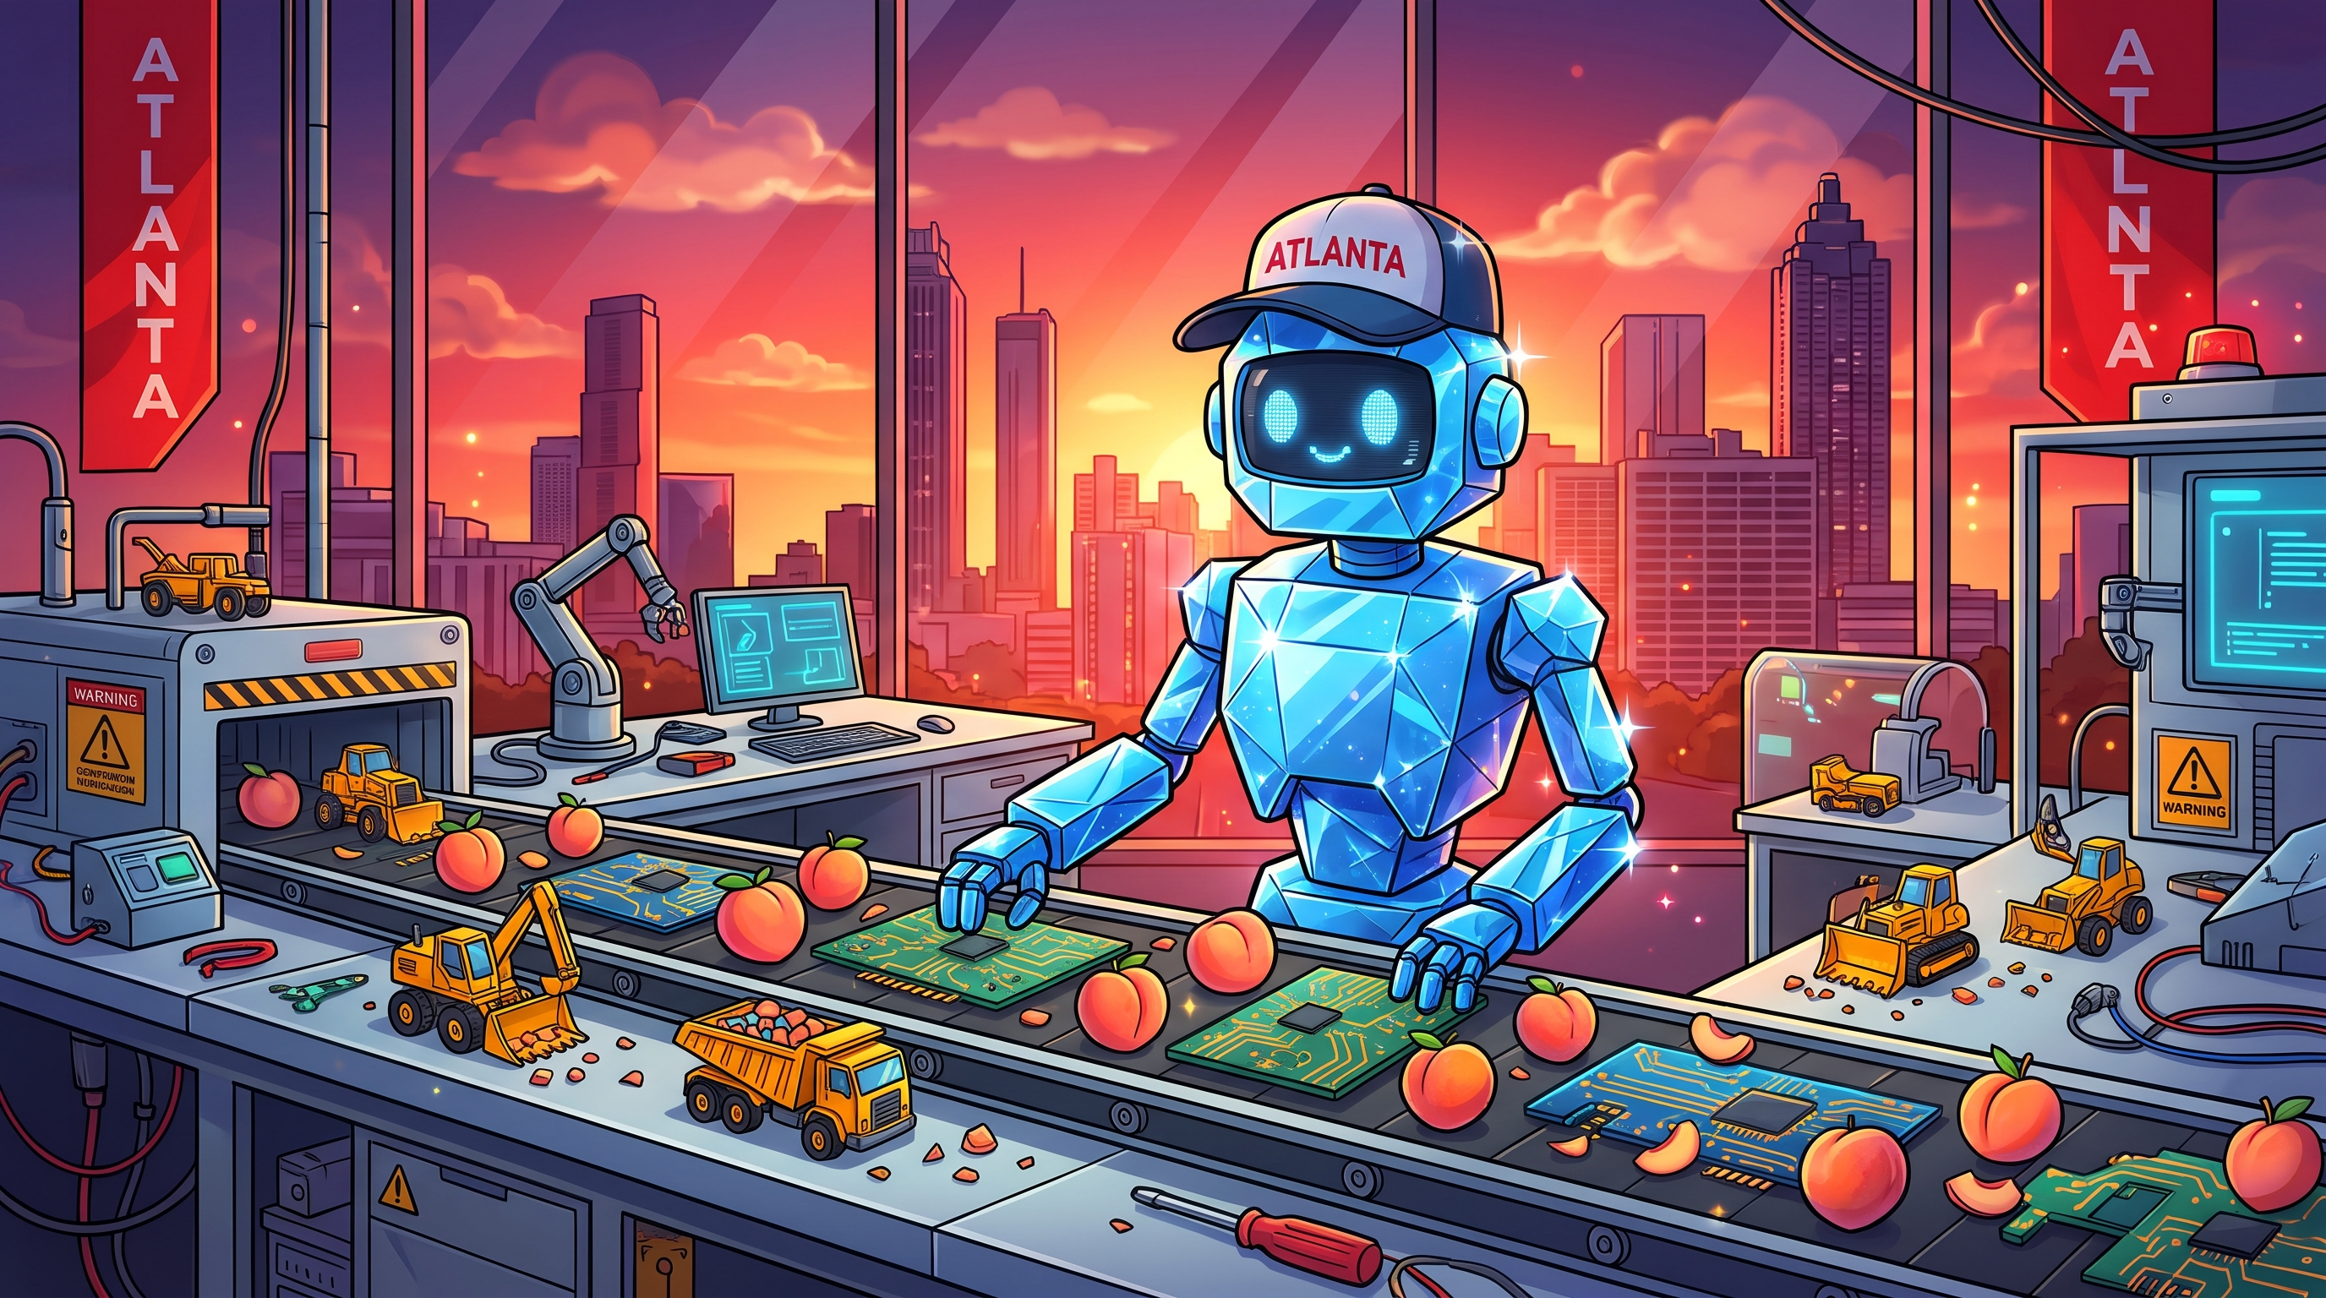
Dev – Quality is ongoing: Test Maintenance
Anytime there’s an error, add a test. Use a skill to enforce this!
Get rid of tests that don’t make sense
Add a subset as a check in gate
Treat tests like real code
You have the time!
Speeding Up Agentic QA · Lincoln, Nebraska
3

Slide 18
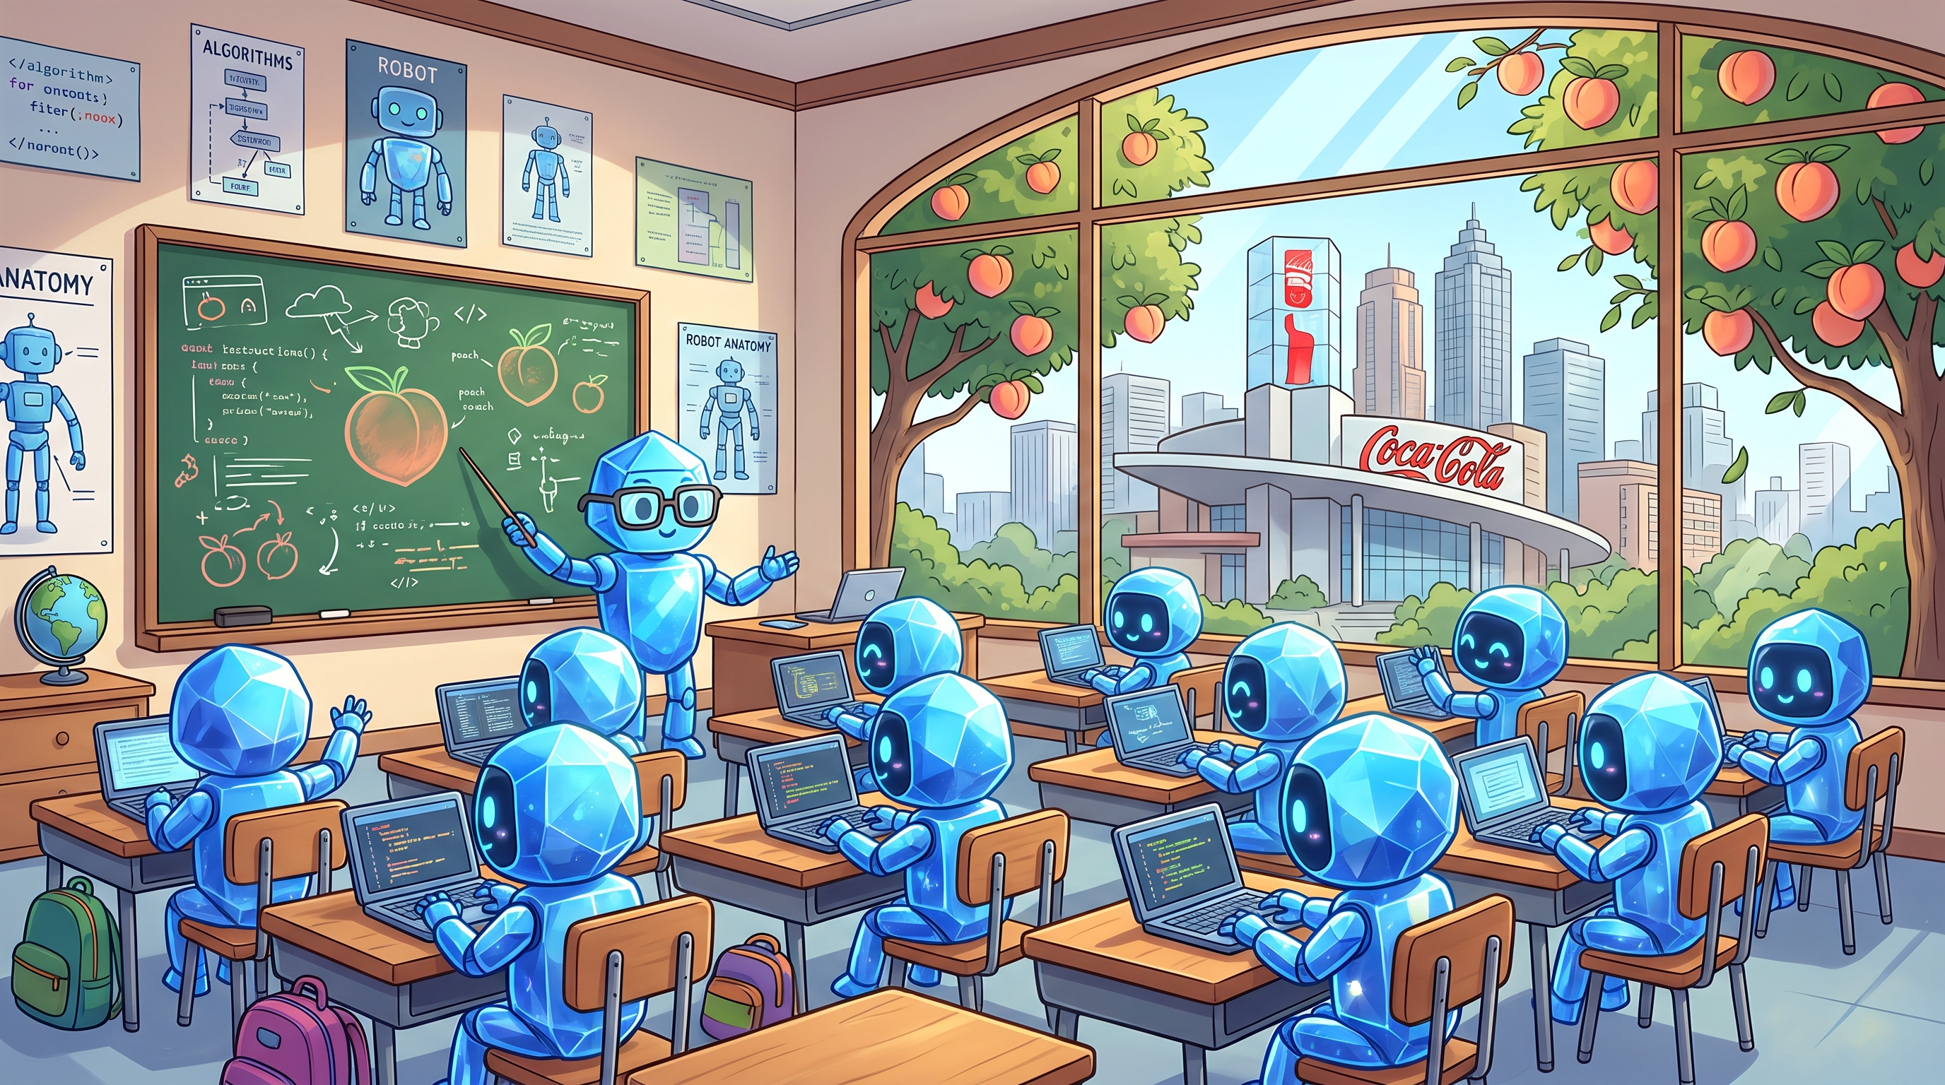
QA – With 3x the code, you must Enforce Standards
You own quality
Devs review to show what is right, QA review to find what’s wrong
You might not own the test suite (that’s up to your org) but you influence it
Teach the team what to look for (you’re saving their jobs, too.)
Create rules for testing AI
Watch test results to look for code drift
Speeding Up Agentic QA · Lincoln, Nebraska
3

Slide 19
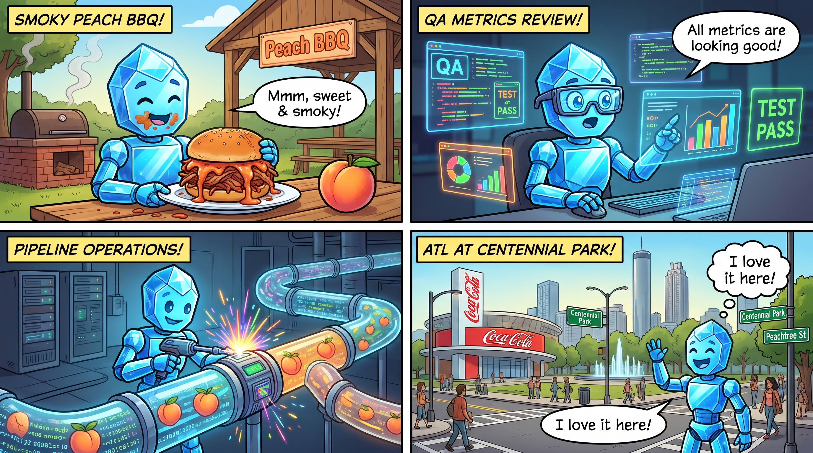
QA – Fight Your Battles
There’s a lot of code coming your way
Manual review of all code may not be possible
You can start skeptical but work to gain trust in AI and your dev team
Never let of go of what’s important, but figure out what’s important
3

Slide 20
QA – Contribute to the Madness
Add code if you can
Build internal tools
Write unit tests, E2E tests, manual tests
Write automated tests
Help educate on the history of what has gone wrong
Get more in the loop and communicate issues with dev
Speeding Up Agentic QA · Lincoln, Nebraska
3

Slide 21
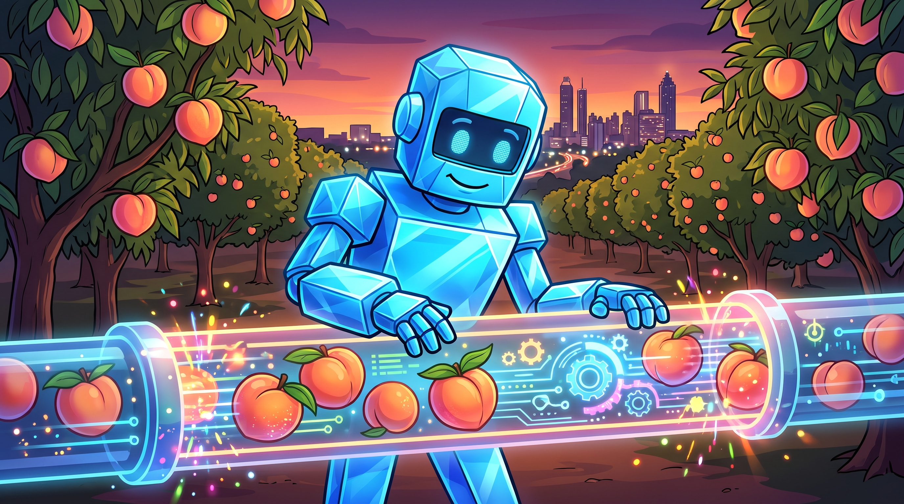
03
Optimizing The Future
The Very Near Future

Slide 22
The Rest of the Story…
If you had to walk out and miss this part, you’d be good.
But those steps optimize for how we’ve always done things
Changes from AI aren’t stopping
Speeding Up Agentic QA · Lincoln, Nebraska
3

Slide 23
All – RETHINK EVERYTHING
Do you need User Stories?
Are your User Stories too small?
What does each step in the pipeline mean if the AI is speeding it up
The AI narrative values speed. How can we be smart and fast?
Speeding Up Agentic QA · Lincoln, Nebraska
3

Slide 24
QA – Ask not what you can do for the robot…
AI is changing your job, too
QA-related AI topics are becoming more plentiful
Find ways to use AI to enhance your judgement (code review, asking technical questions, confirming suspicions, etc.)
Learn QA automation
Fight to be the human
AI testing changes everything
Automate (especially manual test cases)
Speeding Up Agentic QA · Lincoln, Nebraska
3

Slide 25
Dev – Keep find ways to add quality
Use AI to document pre- and post-build states
AI-based rapid prototyping
Skills, skills, skills
Speeding Up Agentic QA · Lincoln, Nebraska
3

Slide 26
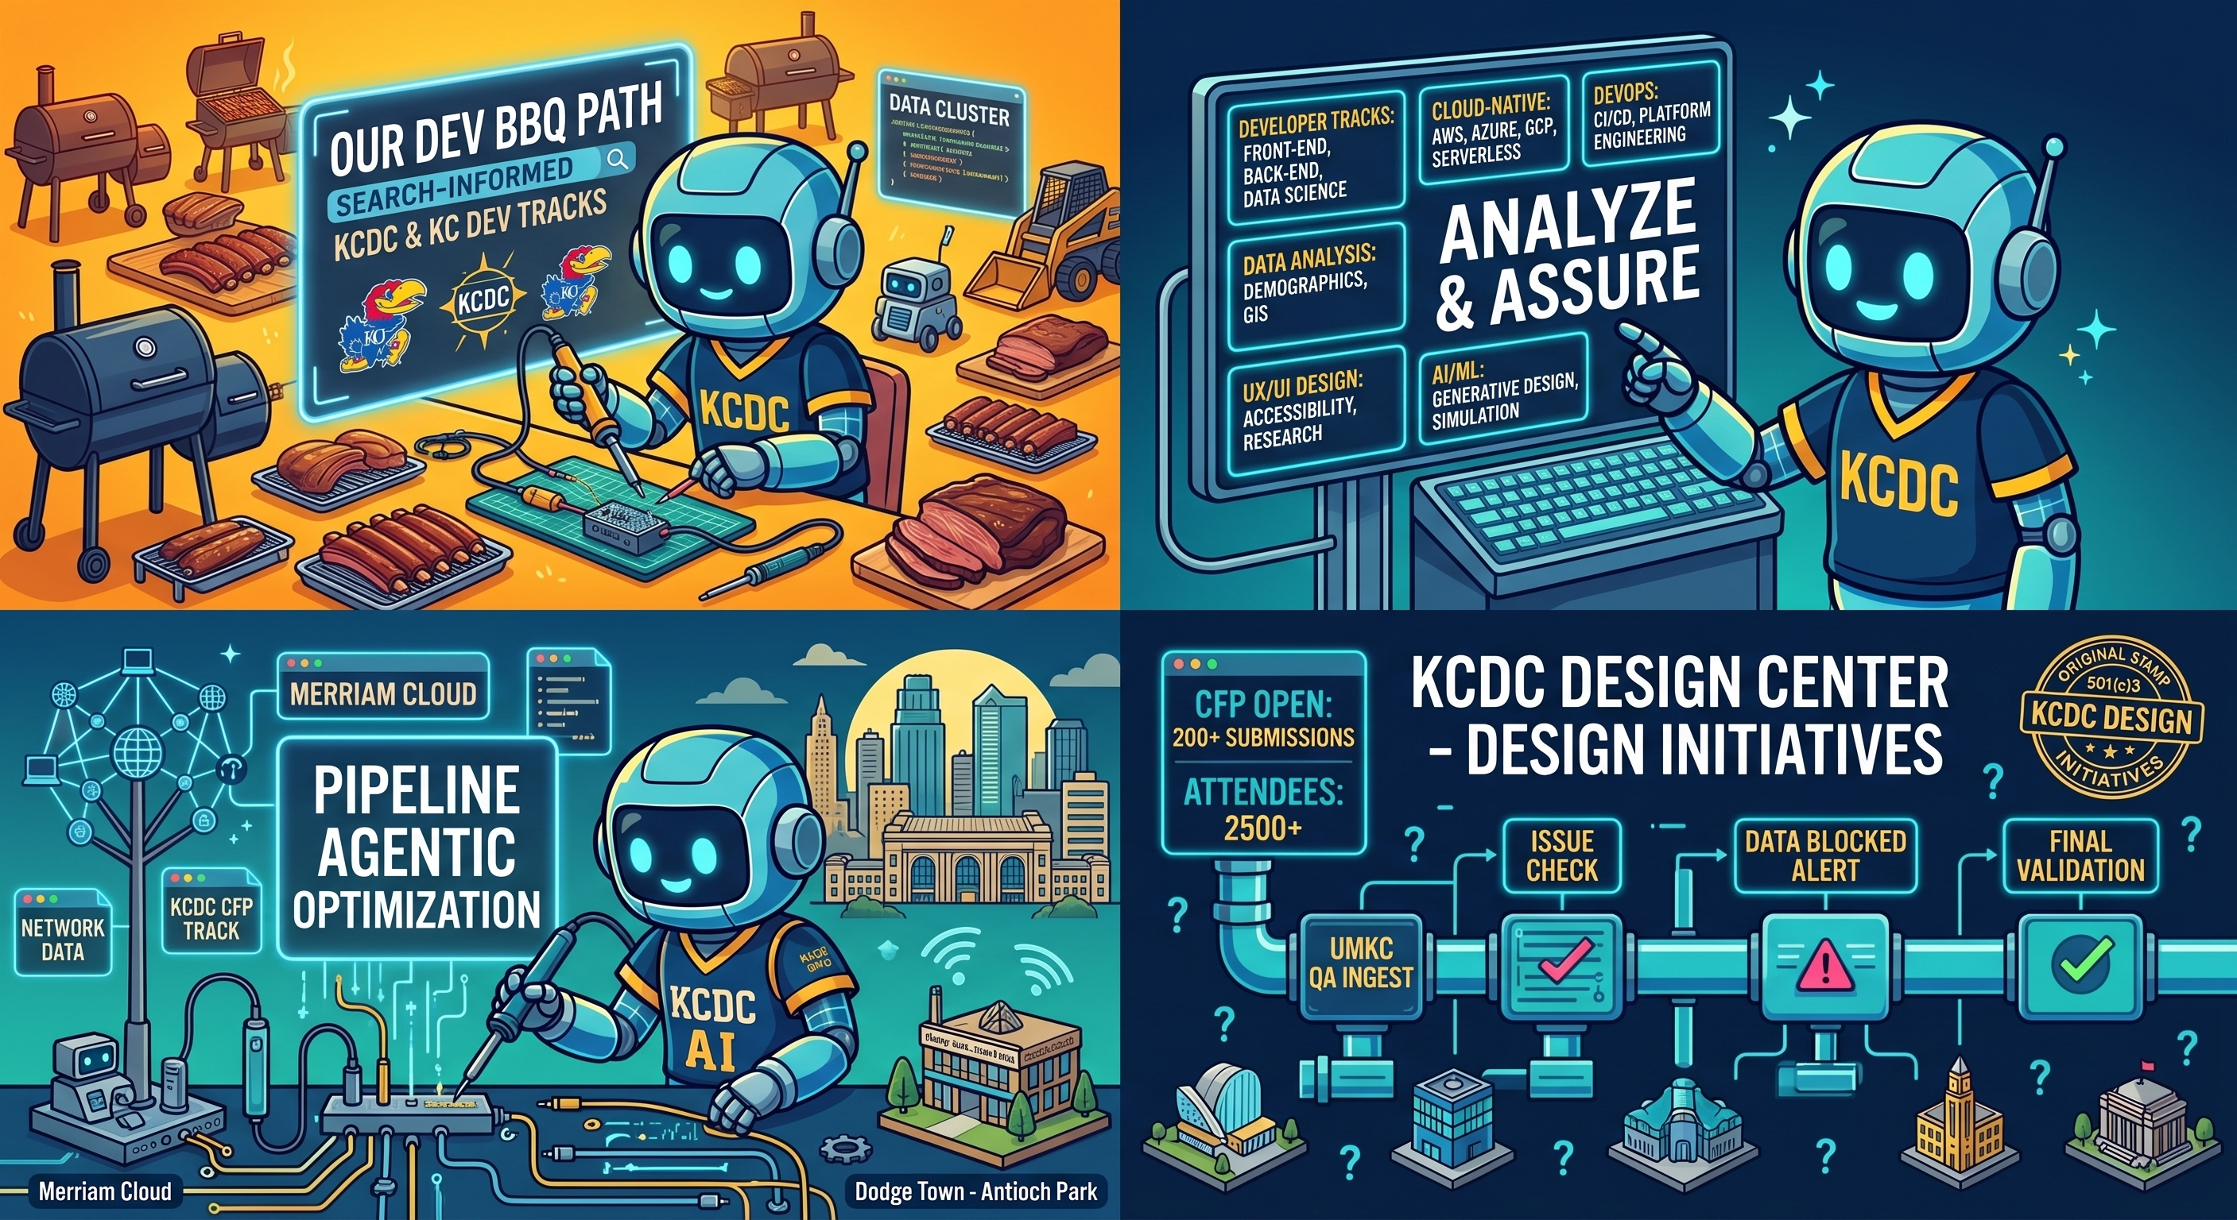
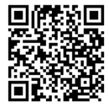
Dev got fast, it’s QA’s turn now
Chris Perrin
@helpfulaiguy

